Slide 1
A Modest Inductive Charger
Team 10
Jeff Brown Kati Dahn
Tyler Gilbert Jann Messer

Slide 2
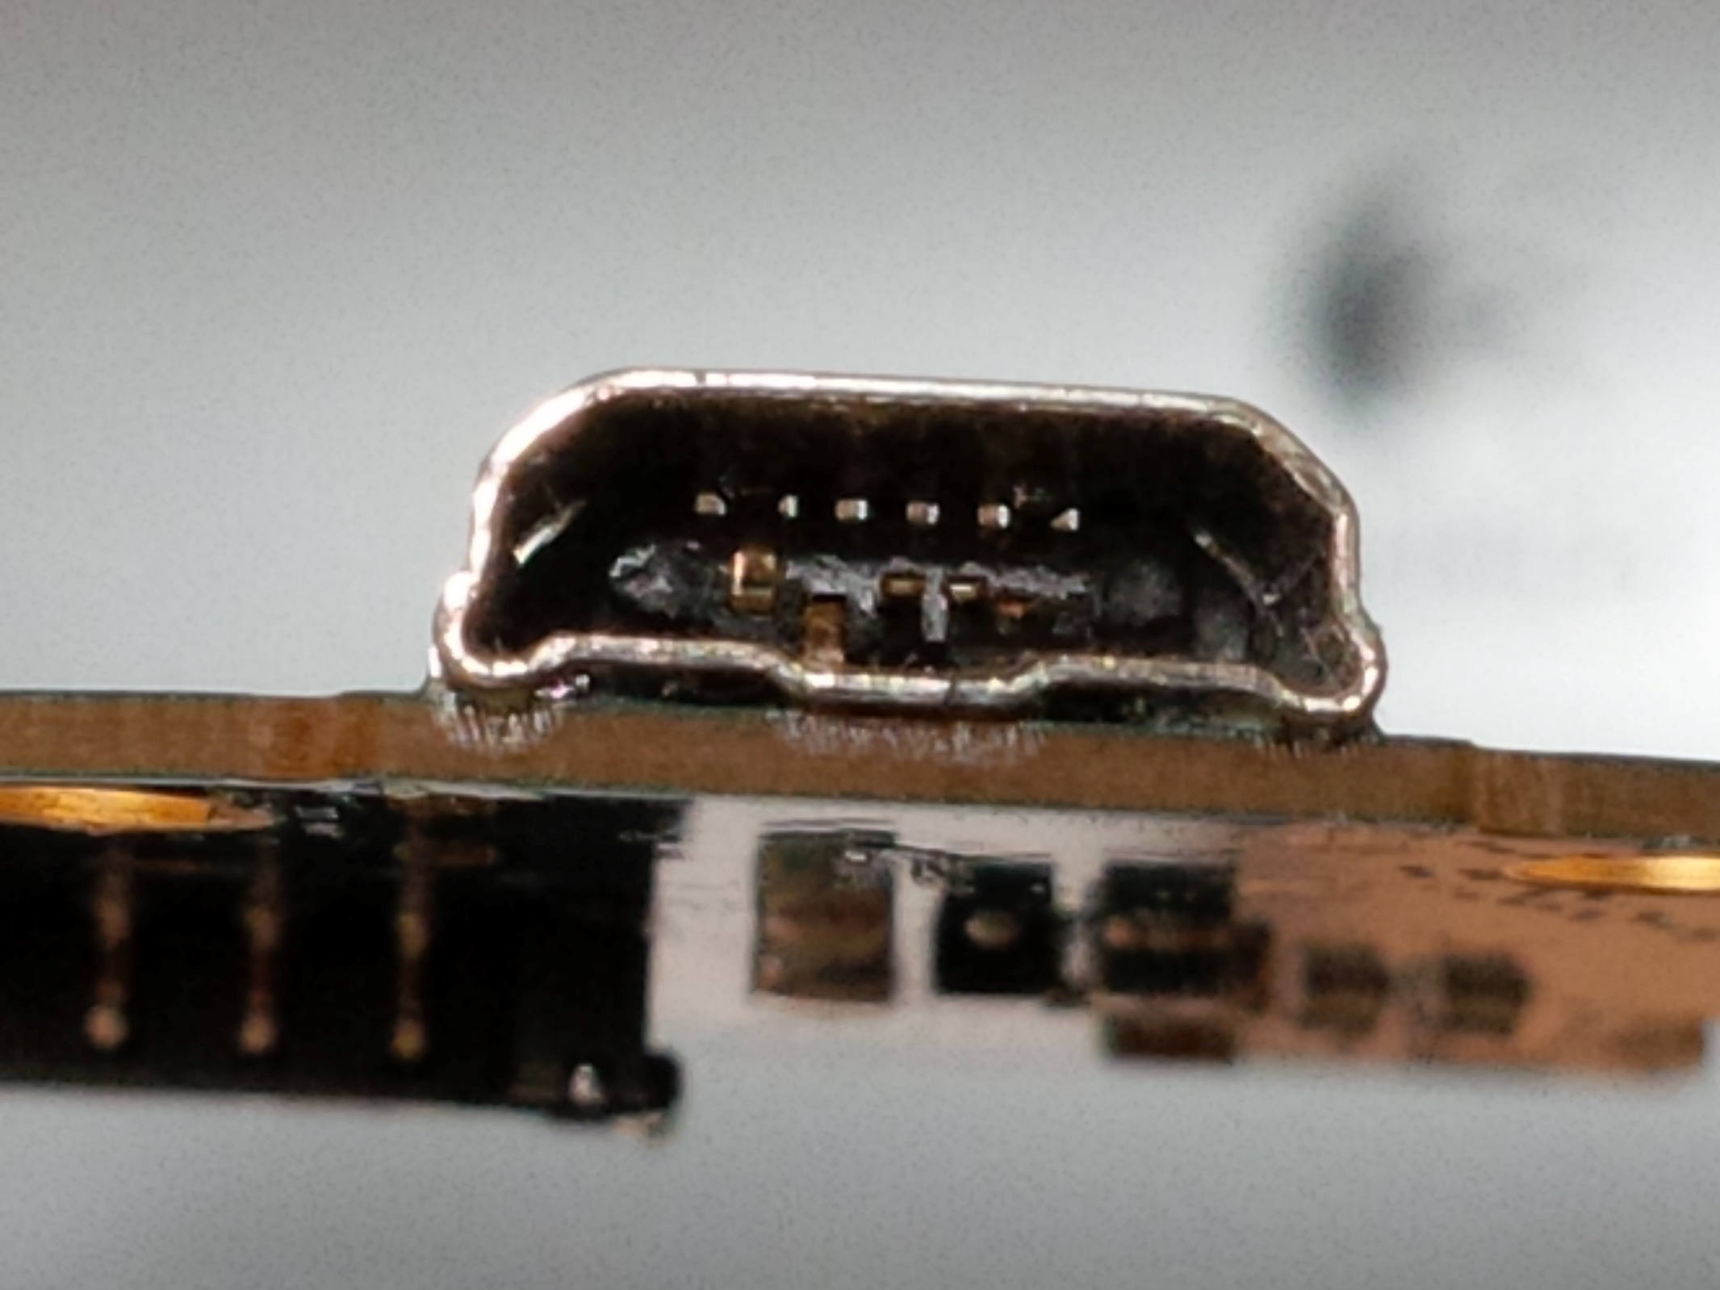
Notes:
“Has this happened to you?” – Motivation of Inductive Charging

Slide 3
Motivation:
“To become more familiar with wireless energy transmission and explore integrating wireless charging technology into consumer electronics.”
Notes:
Motivation: While this technology is already commercially available and several wireless charging standards exist (Qi, Rezence), the purpose of this project is to become more familiar with wireless energy transmission and explore the feasibility of integrating wireless charging technology into consumer electronics.

Slide 4
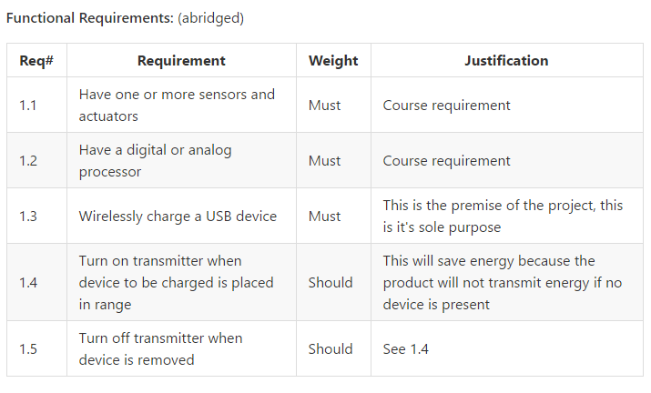
Notes:
Pause here a moment, than advance slide.

Slide 5
Notes:
The Objective – “Wirelessly charge a USB device” That’s It!
To explicitly address the second sentence – a working prototype is desired.

Slide 6
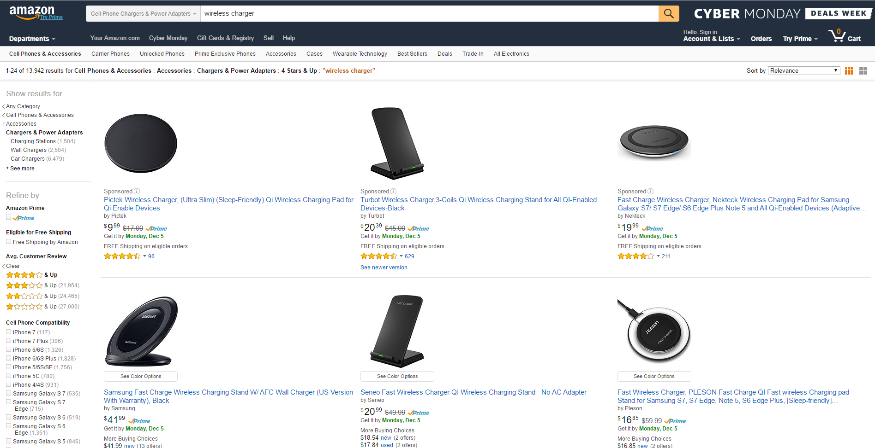
Notes:
Existing Solutions
Like our objective, many of these products target the USB devices market.

Slide 7
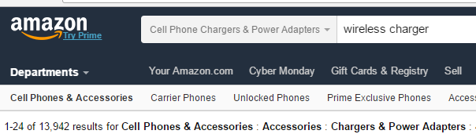
No wheel reinvention here.
Notes:
Continued from previous slide
As Amazon shows us, their exist a plethora of options available.

Slide 8
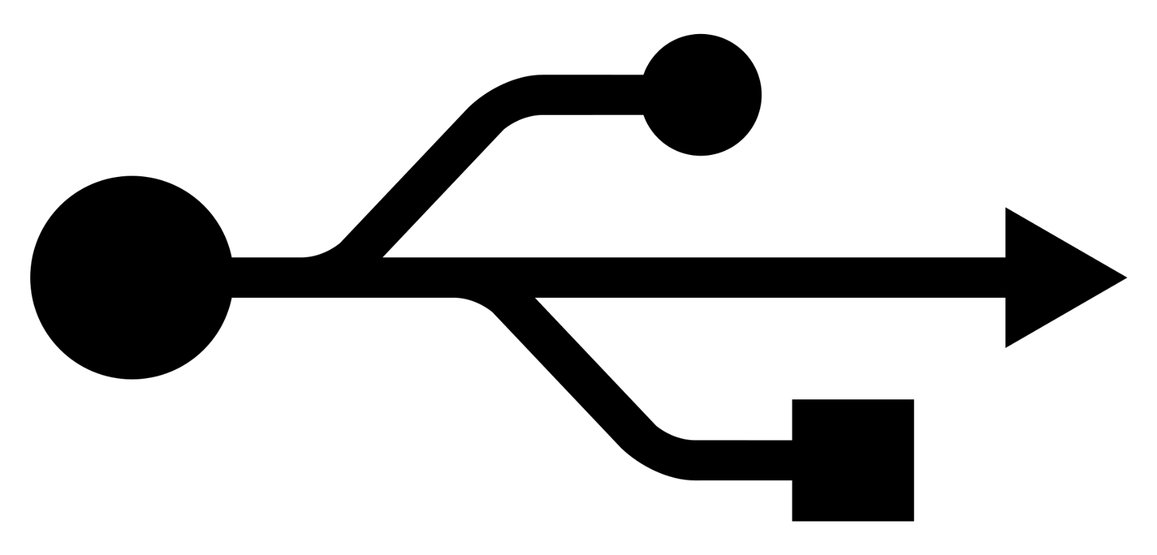
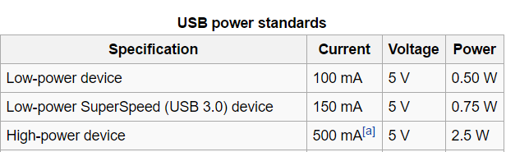
Notes:
Requirements –
An acceptable solution would be a device that supplies USB spec power.

Slide 9
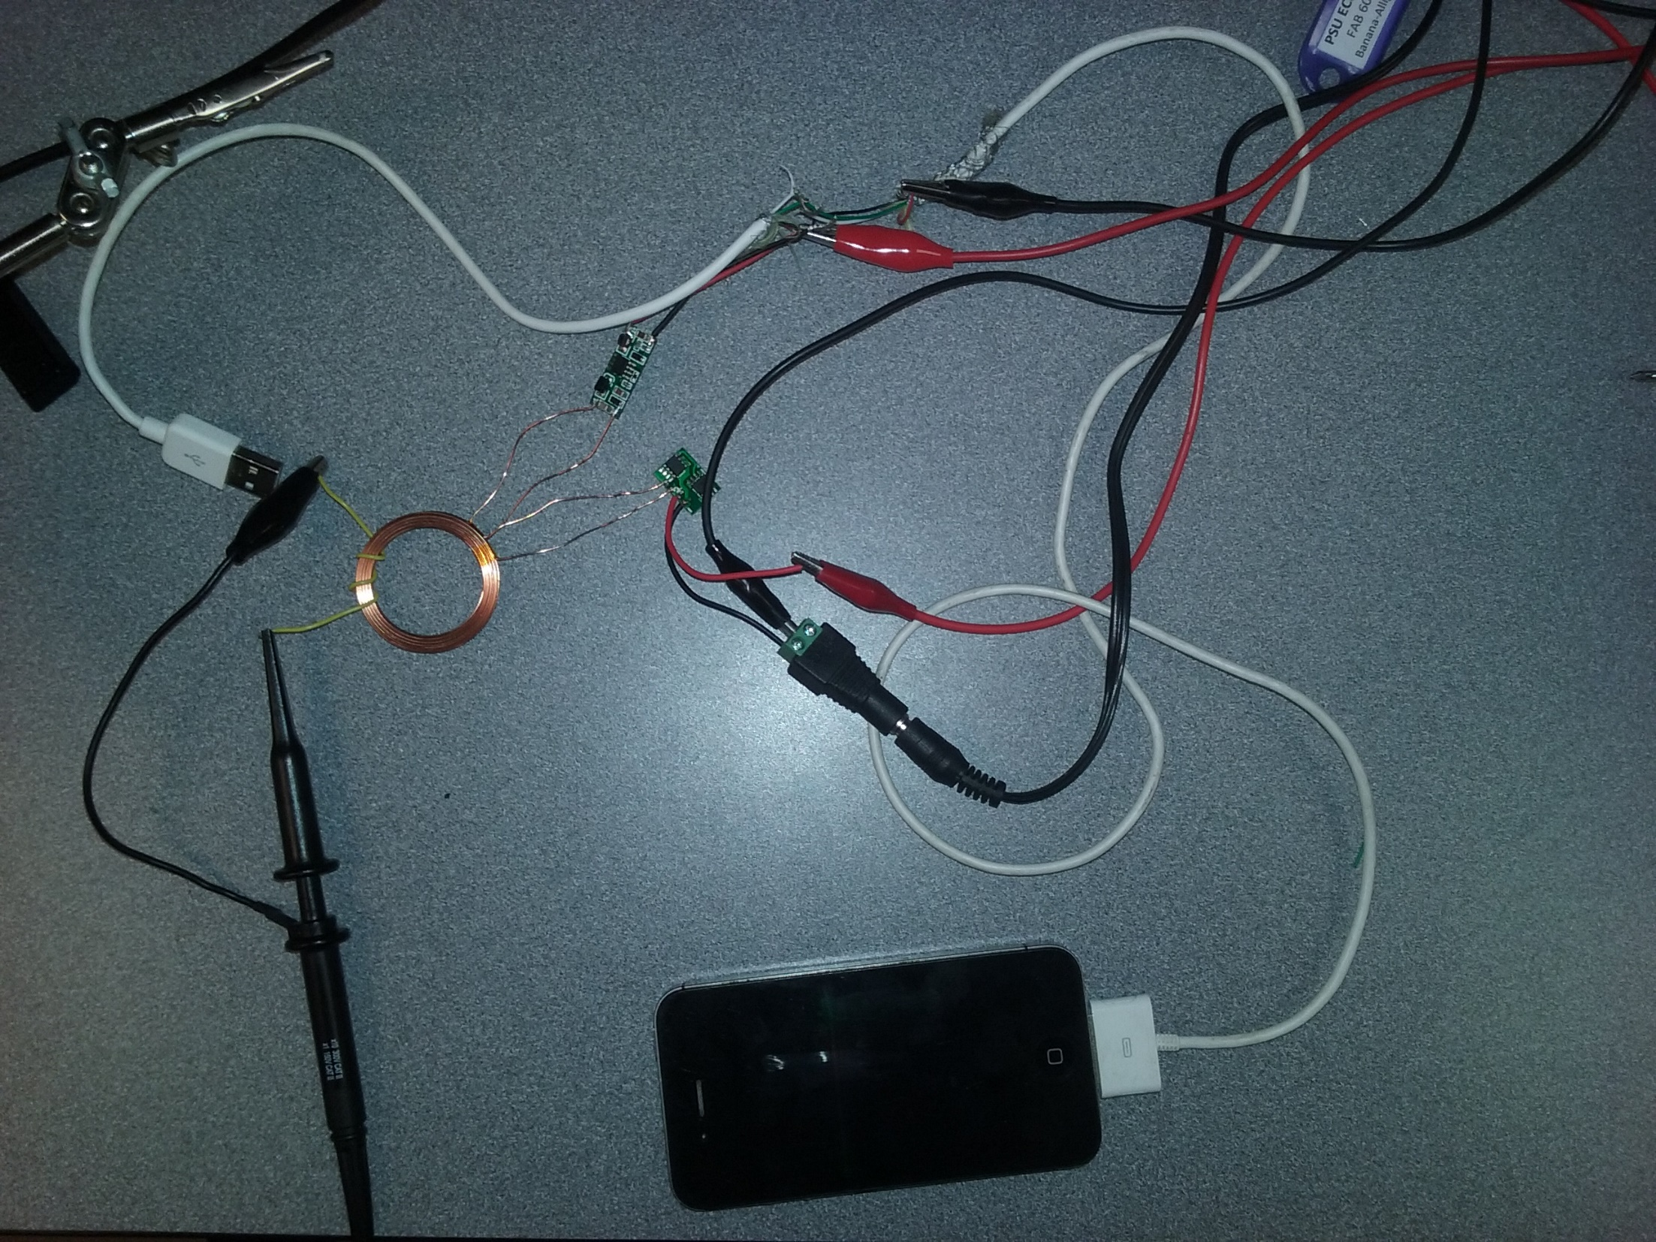
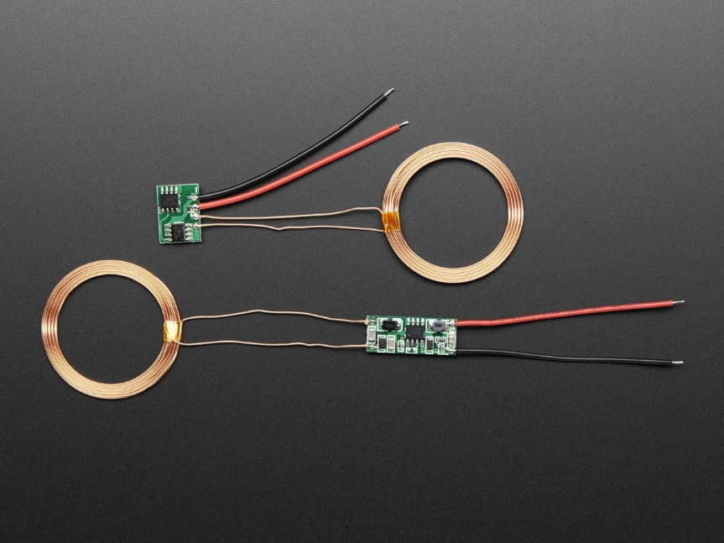
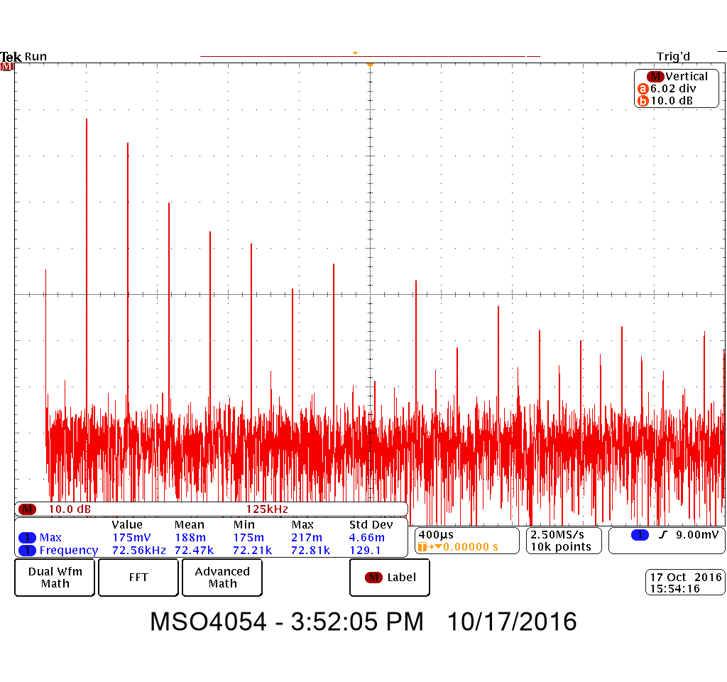
Notes:
Approach – Test and Characterize an existing product. Seen here is a set from the Adafruit company. We turned the set on and used a few turns of hookup wire as an inductive tap. With this we were able to characterize the output waveform. Seen in the lower right of this slide is an FFT of the transmitter. This waveform is rich in harmonics. This led us to believe that sinusoidal driving isn’t necessary - wave shaping isn’t critical. Incidentally the time domain waveform looked like a half rectified sine wave with jitter.

Slide 10
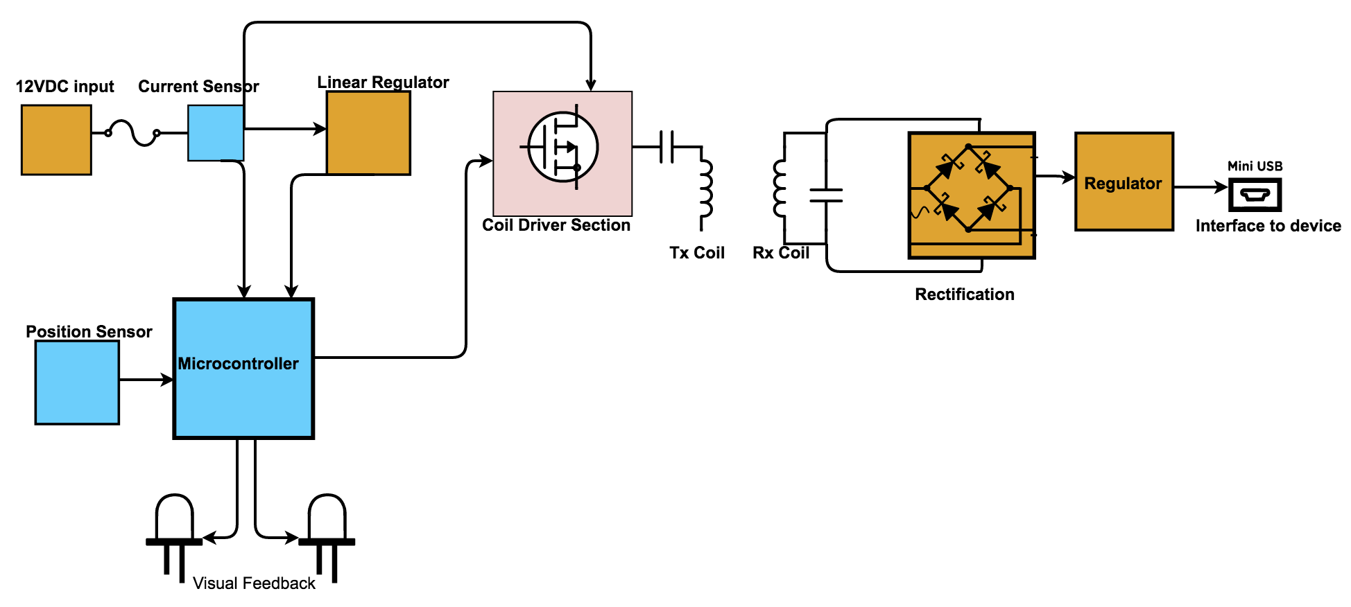
Notes:
Design Overview

Slide 11
Notes:
Design Overview

Slide 12
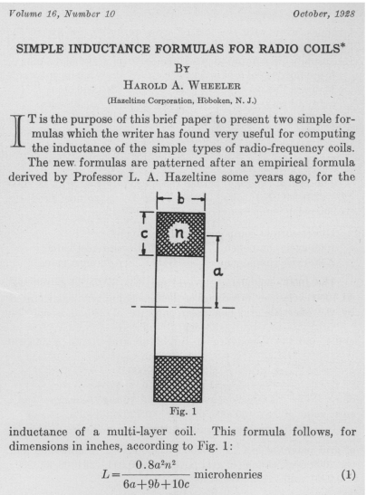
Harold A. Wheeler, "Simple Inductance Formulas for Radio Coils," Proceedings of the I.R.E., October 1928, pp. 1398-1400.
Notes:
QUESTION: Did we actually use this formula? I thought we just hooked it up at our driving frequency and measured the inductance.

Slide 13
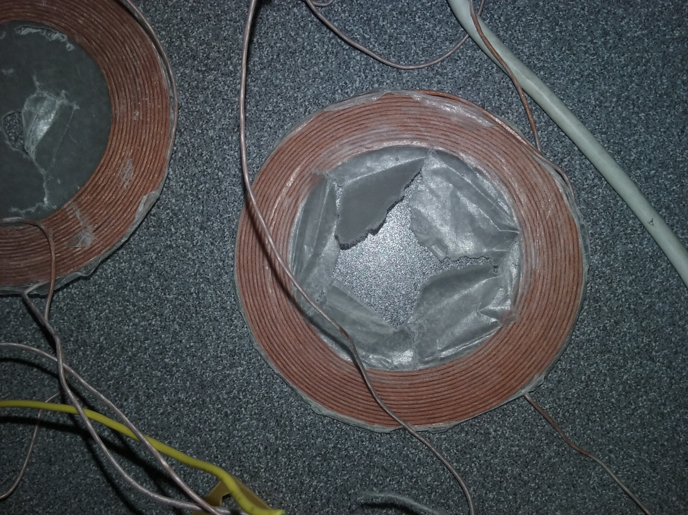

Slide 14
Notes:
Design Overview

Slide 15
Notes:
Design Overview

Slide 16
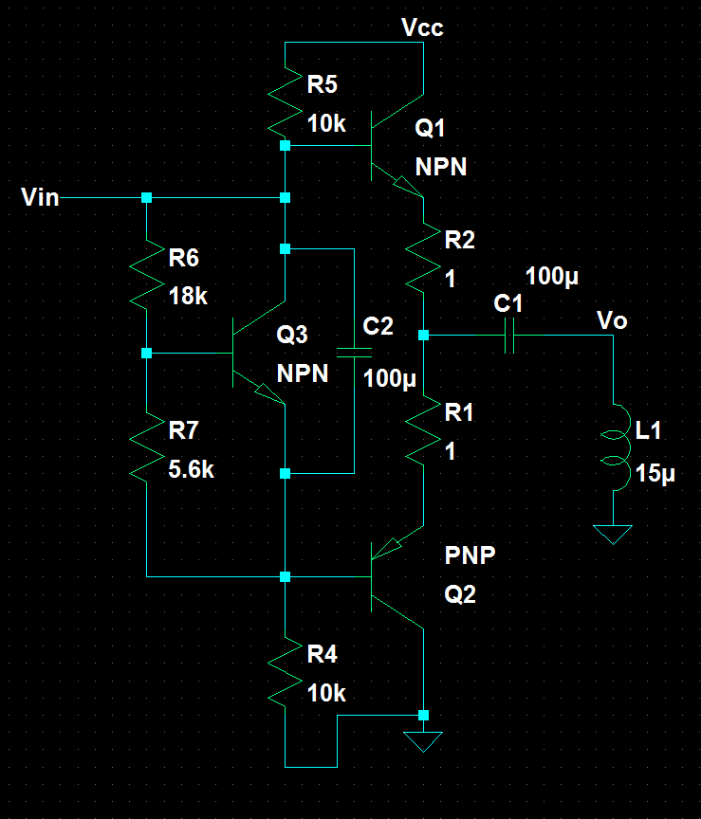
Notes:
Initial Output stage development
In another class we studied “Complementary Symmetry Amplifiers” an energy efficient and simple circuit.
In LT Spice this worked and met our design spec.
The design proved to be unnecessarily complicated and a single common collector power transistor or array of 5 parallel smaller transistors worked well and was a much simpler design and took up less board space.

Slide 17
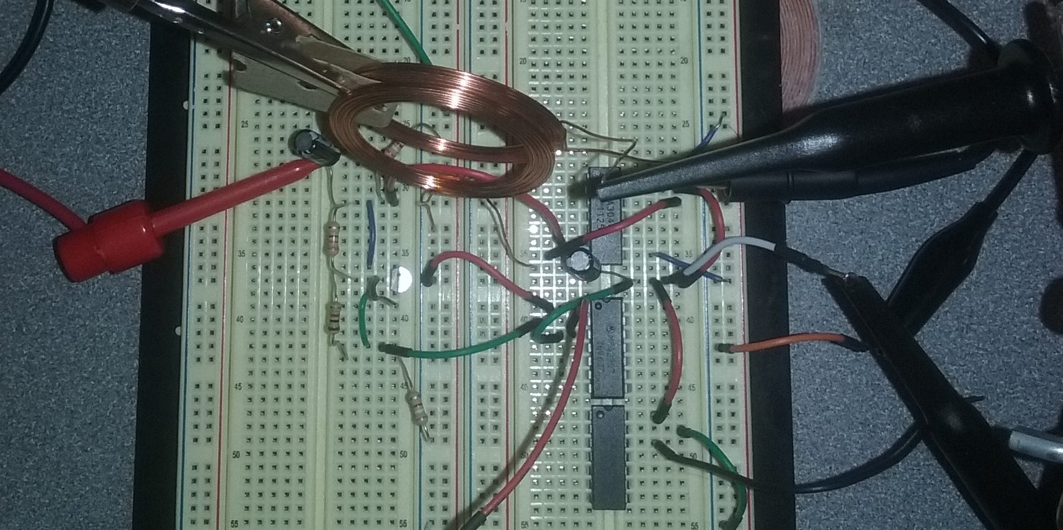

Notes:
Implementation
The circuit from before was built and tested with transistor arrays and single transistors. At first we used 2N3904s. Given a max collector current of 200 mA we reckoned 5 transistors or
So in parallel, depending on coupling efficiencies, would meet the USB power spec.
We constructed this circuit and it wasn’t quite what we expected. The warning decal in the corner gives some indication of what.
The why is, of course, nothing was heatsunk during testing.
This conclusion however was only reached after some non-trivial lab time. Many transistors had burned out but it wasn’t obvious with some of them. Additionally some transistors in our toolboxes were burnt out in ECE 322 but we had neglected our duty of throwing them out then.
Testing several with a curve tracer confirmed the suspicions. One lab session however our enthusiasm for carrying on was deterred by an acute lack of working transistors. Fortunately however we found a
stash of N-type Mosfets.
In this test case the transistors were being driven by a sine wave which was also largely contributing to the acute heat dissipation in the transistors. More explained on this in later slides.

Slide 18
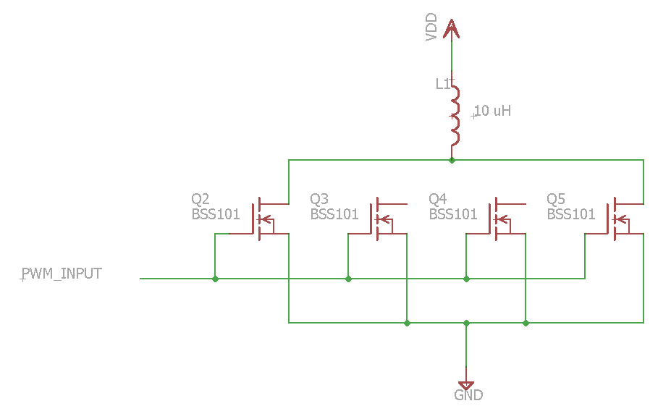
Notes:
After experiencing excessive heat dissipation in the transistors driving the coil and analyzing the FFT of the adafruit charging kit we realized that it was actually more efficient to drive the coils with a square wave rather than a sinusoidal wave. A direct PWM signal was sent into the driving transistor circuitry and proved our deductions correct.
The main reason for the greater efficiency in using a direct PWM input signal is because the mosfets only heat up when they switch and with a sine wave we are extending the period of time over which they switch. Whereas a square wave is much more near instantaneous and therefore the transistors don’t get nearly as hot.
This allows the coils to dissipate the heat rather than the transistors which is favorable due to their larger surface area as compared to the transistors.

Slide 19
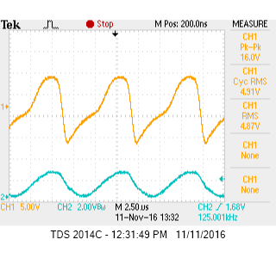
Oscilloscope capture of receiver coil with MOSFET output stage
Notes:
Success!
This was a first pass at successful and useful output
However this was improved later by measuring the resonant frequency of the various coils we made. We found the homespun Litz coils the most efficient and we measured the resonant frequency to be around 2MHz.
Since our transistors had a maximum switching frequency of 4MHz we changed our PWM to this frequency and power transfer was much better.
But for regulating this to DC we decided it would be much more beneficial to work with a lower frequency, so we added a cap for an LC resonant frequency of 246 KHz, which was an improvement in efficiency and the output was about 5 V peak.

Slide 20
Notes:
Design Overview

Slide 21
Notes:
Design Overview

Slide 22
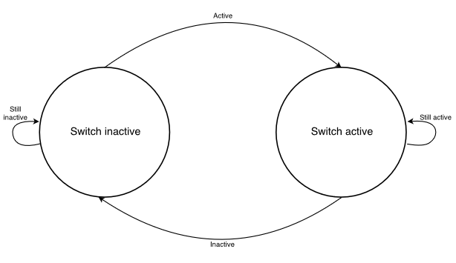
System State Machine Diagram
Notes:
Only two simple states
Implementation shown on next slide

Slide 23
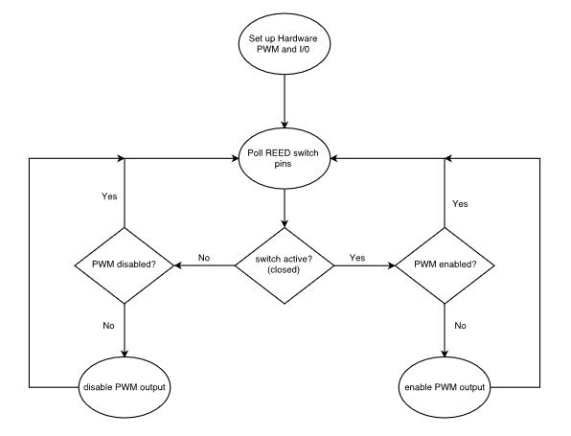
System State Machine Diagram
Notes:
Basic Microprocessor code
Not stressing the uP too much

Slide 24
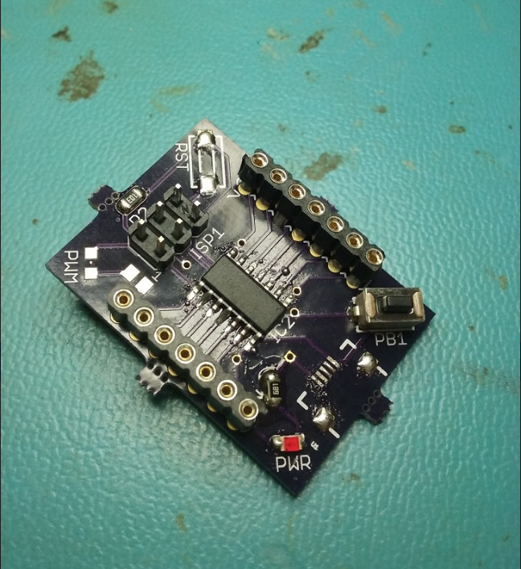

Slide 25
IP / prior work maybe ref. slide 8

Slide 26
